Slide 1

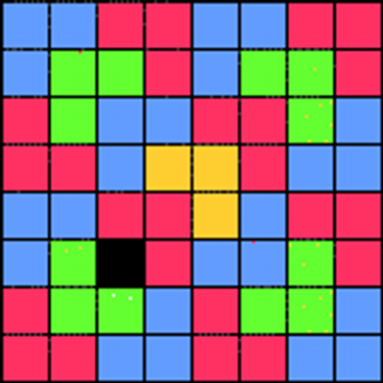



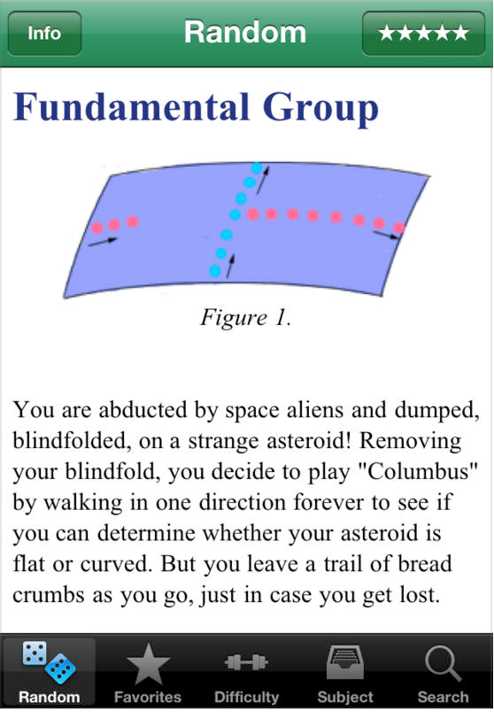
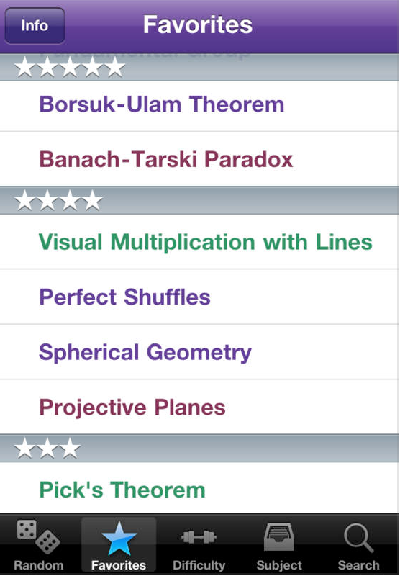
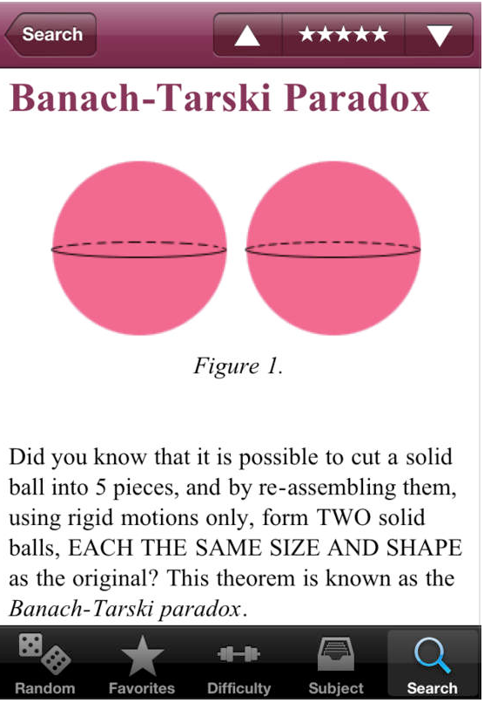
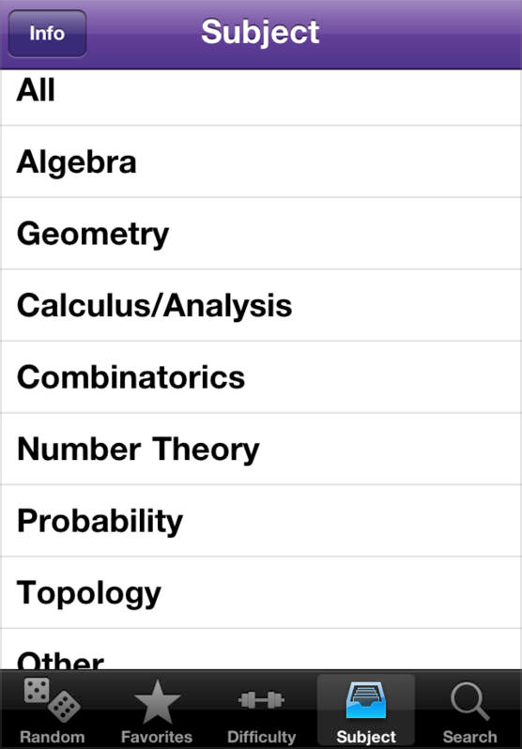
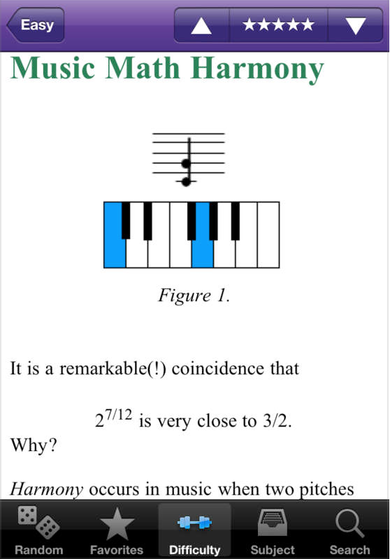


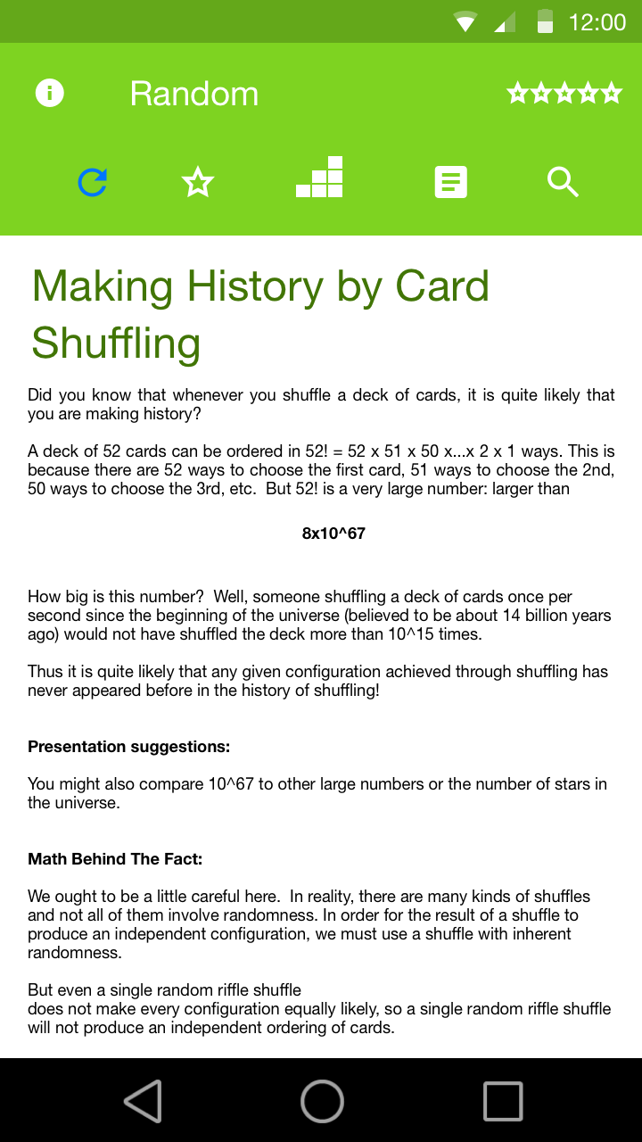
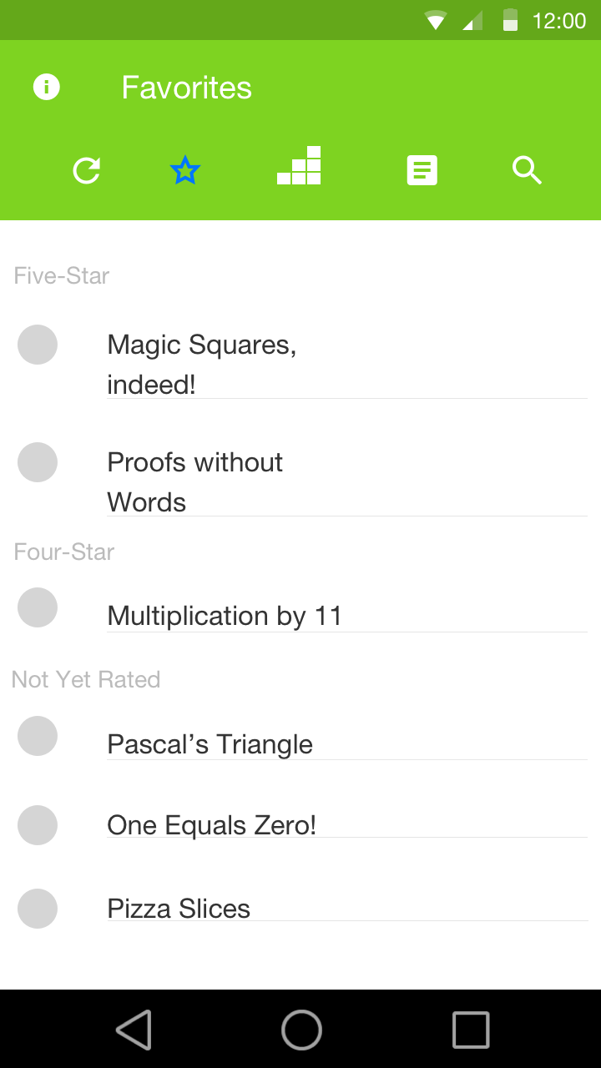
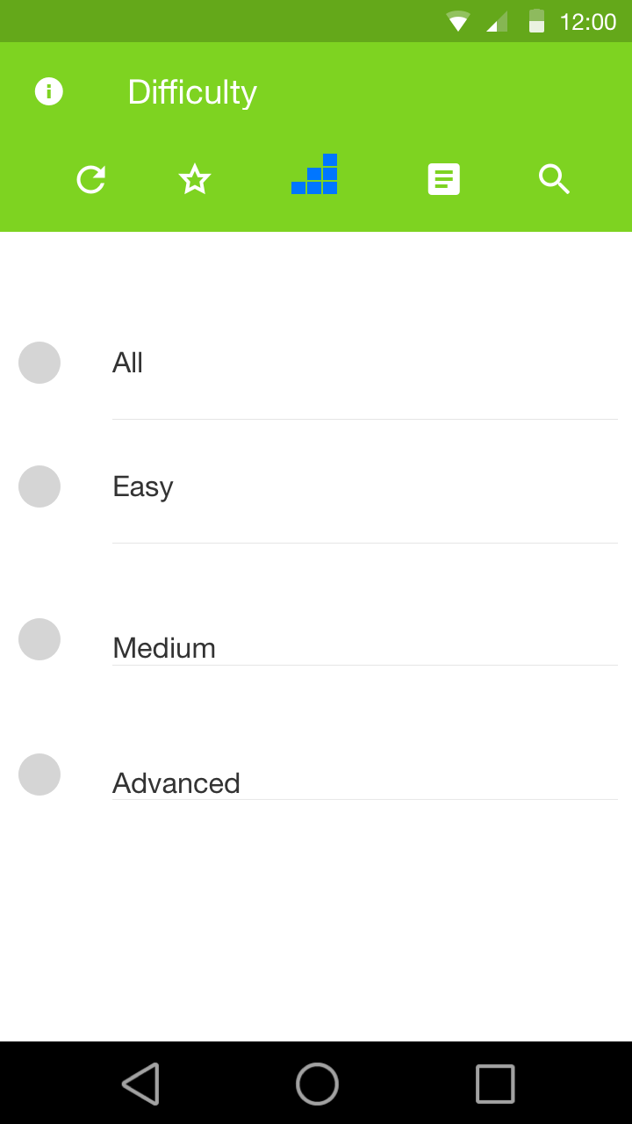
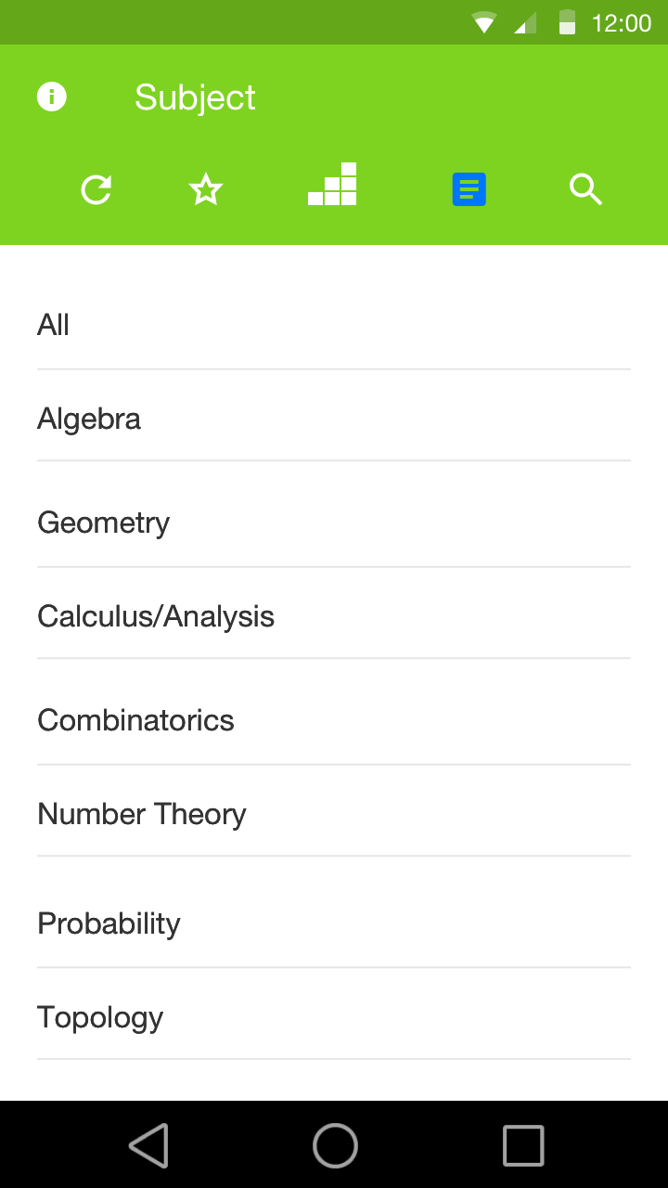
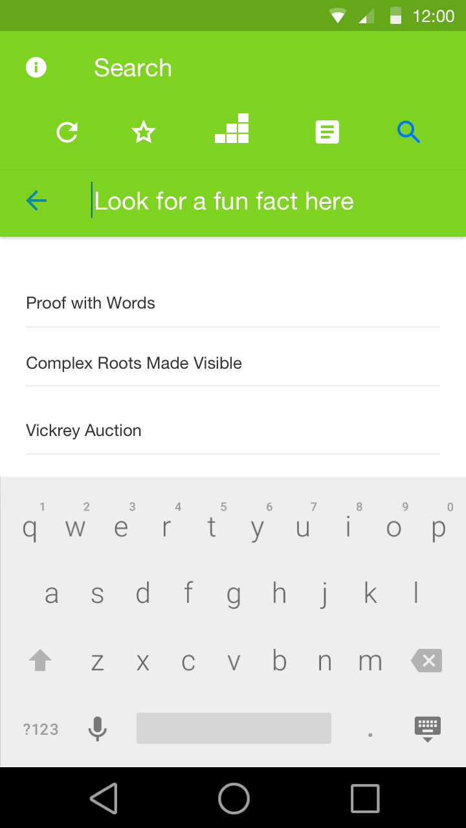
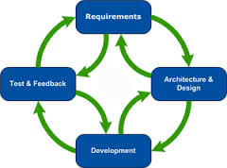






Math Fun Facts
An Application for the Android Platform
Anders Chaplin, Aidan Cheng, Ali Elabridi, Anant Jaitha
Motivation
In a Nutshell
● Math Fun Facts gives users fun facts and brain teasers about math
● Facts can be randomly generated, or sorted and selected by properties such as difficulty level and subject
●A user can also find facts by searching for them, either by keyword or title
Data Storing / File Management
Math!
● Local, persistent data storage
● Files are classified by their info
● Files are parsed on app start
● Rating is read on app start after parsing
● Use of different ways to filter and sort data
Math
Client is President of Mathematical Association of America
He has his iOS and web application
Math Fun Facts
New Fact
What We’ve Learned
Back-end Architecture
Challenges
Future Work
Free and Paid versions
Read and Unread Fun Facts
Cool Ways to Randomize Fun Facts

